Slide 1
Retail Extract Hub
ETL Pipeline for Scalable Data Integration and Analysis
~ Lalithya Kalluru

Slide 2
Table of Contents
1. Introduction
2. Architecture
3. Methodology
4. Schema
5. Challenges
6. Conclusion

Slide 3
Introduction
This project, focuses on integrating retail data from multiple sources using an ETL pipeline.
Retail businesses face challenges in managing large, inconsistent data from orders, payments, and reviews.
The project ensures seamless data integration, improves accuracy, and enables sales performance insights.
The final outcome is a structured database that supports efficient data storage, retrieval, and real-time insights.

Slide 4
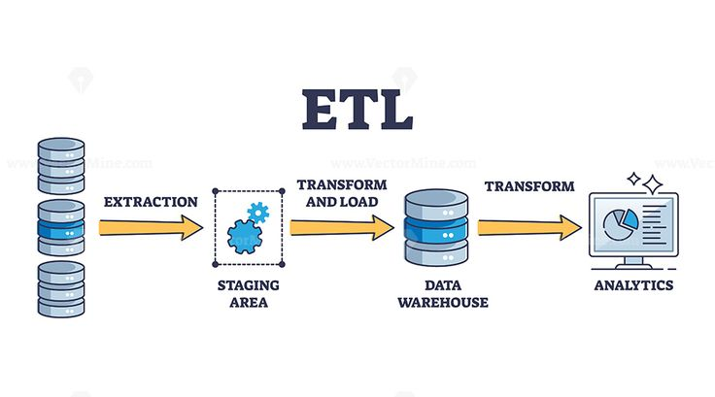
Architecture

Slide 5
Methodology
1. Data Extraction :
Collecting data from Kaggle CSV files.
2. Data Transformation :
Cleaning null values and remove duplicates.
Formatting and structuring data.
3. Aggregation :
Compute KPI’S and data marts.
4. Data Loading :
Load CSV files into MySQL.

Slide 6
Schema
Database schema illustrate the relationships between tables.
Fact Table : Fact table is the central table that contains transactional sales data and serves as the main fact table in the schema stores quantitative data (e.g., sales, revenue, order count).
Dimension Tables : store descriptive (categorical) data about the facts that help analyze data in fact tables.
dim_dates : Stores date-related attributes to facilitate time-based analysis.
dim_payments : Contains payment transaction details, including payment types and amounts.
dim_products : Maintains product-specific information like categories, descriptions, and attributes.
dim_sellers : Stores seller details such as location and identification.

Slide 7
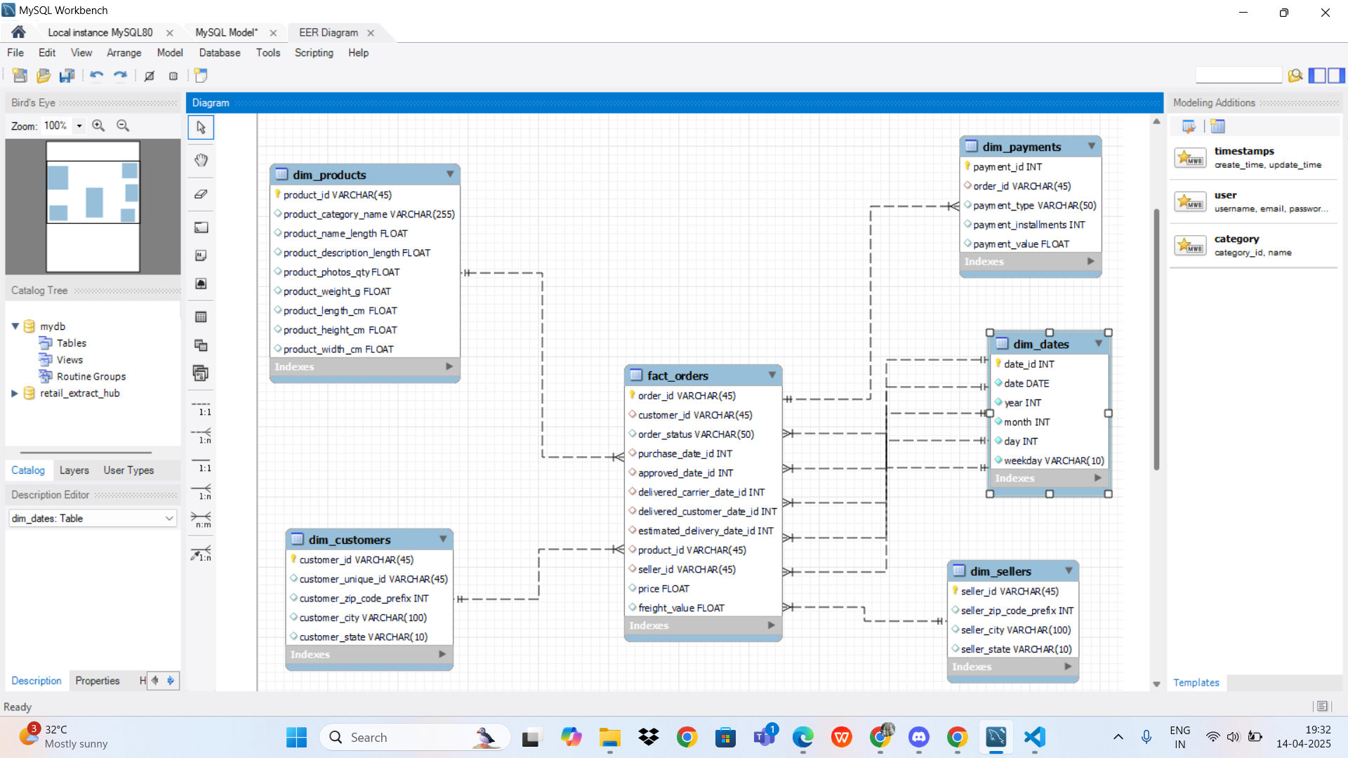

Schema Diagram

Slide 8
Challenges
Large Data Processing : Faced difficulties in efficiently handling large datasets, which required optimizing storage and processing techniques.
Data Quality Issues : Managing missing and inconsistent data was challenging, as it required thorough data cleaning and validation.
Data Inconsistency : Data parsing is also one of the challenges faced during building the project where the data is not consistent for analysis directly.
Merging Data from Multiple Sources: When combining data from different sources (like CSVs and SQL), making sure the data aligns correctly (e.g., matching IDs or product categories) can be challenging.

Slide 9
Conclusion
Successfully built an end-to-end ETL pipeline for retail analytics using Python and SQL.
Centralized retail data from various sources for better insights and reporting.
Performed data cleaning, transformation, and aggregation to support business decisions.
Generated key reports on sales performance, inventory trends, customer behavior, and profitability.

Slide 10


